Slide 1

What contributes to fraudulent car insurance claims in the USA and how can it be classified in the future?
By Callum O’Neill

Slide 2
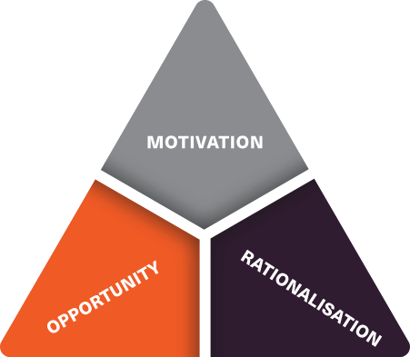
Fun facts
1. Insurance fraud costs the USA, $308 billion dollars annually
2. Motives:
-financial struggles
-addiction
-cheat their policy holders
3. Psychology of fraud triangle (below):

Slide 3






Contents
1. Overview of data
2. Data cleaning process + tools
3. Analysis and visualisations
4. ML classification
5. Recommendations and conclusions
6. Recap

Slide 4
Overview of data: Fraudulent Insurance claims from car physical damage: 2015 - 2016
Ethical considerations:
-Public on Kaggle
-names remained anonymous
-salary, age (both subjective upon disclosure)
Limitations:
-null numerical values
-minimum salaries were branded as -1
-missing category data
-only 2015 and 2016 were available

Slide 5



Data cleaning process + tools
Data cleaning: Python and pyspark
Data pre-processing: Python (machine learning)
Data visualisation: powerBI and python (ML outputs)
null numeric values - mean (except for salary and age)
One hot encoding – assigning unordered categories to columns
PowerBI – primary visualisation tool. Insights and characteristics
Python – visualisation of ML parameters
null string values – most common (except for salary and age)
Label encoding – assigning ordered/high volume categories to columns
Category mapping - age, salary, liability %, safety rating
Column removal – irrelevant, inappropriate for classification

Slide 6
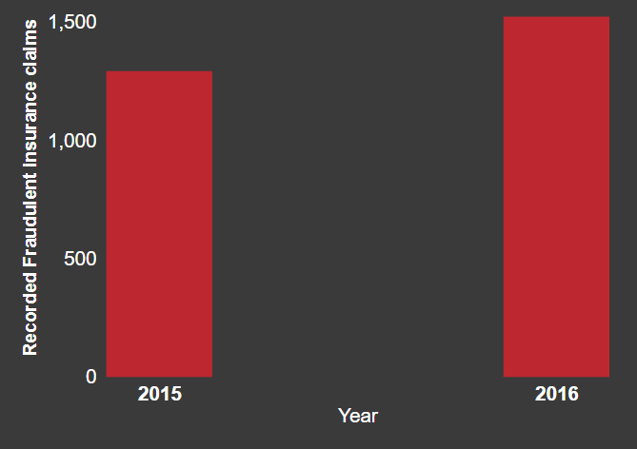
Has fraudulent claims increased from 2015 to 2016?
From 2015 – 2016:
17% increase

Slide 7
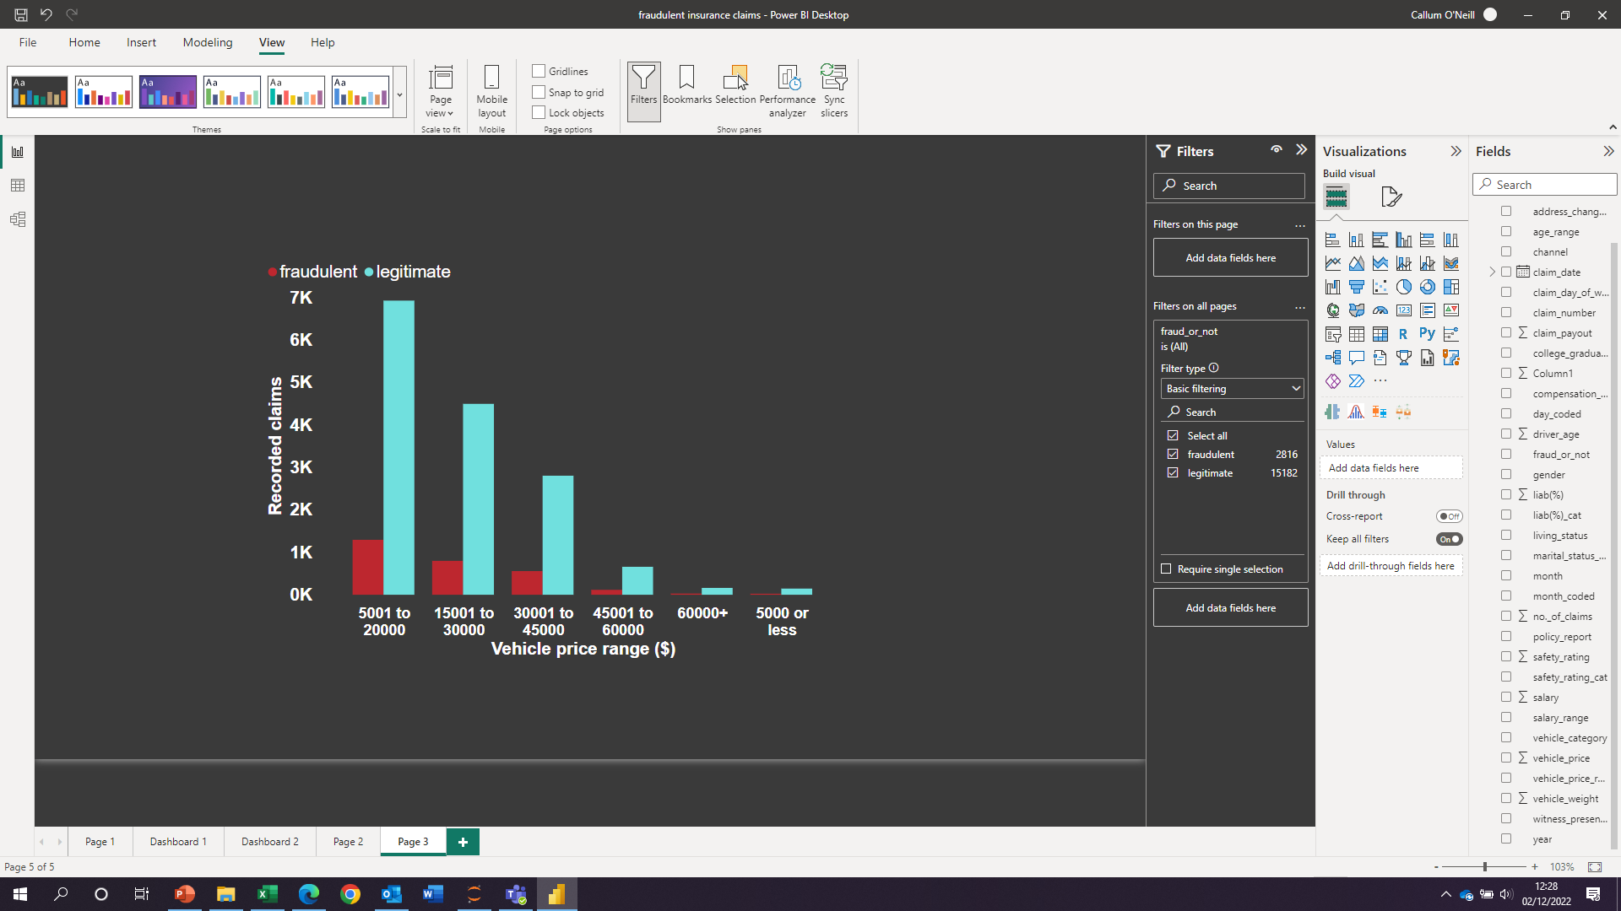
Cars are a liability. Would a greater liability cost prior to insurance influence fraud across both years ?
Most fraudulent claims:
$5001 - $20000
$5001 - $20000
Fraudulent: ~18%

Slide 8
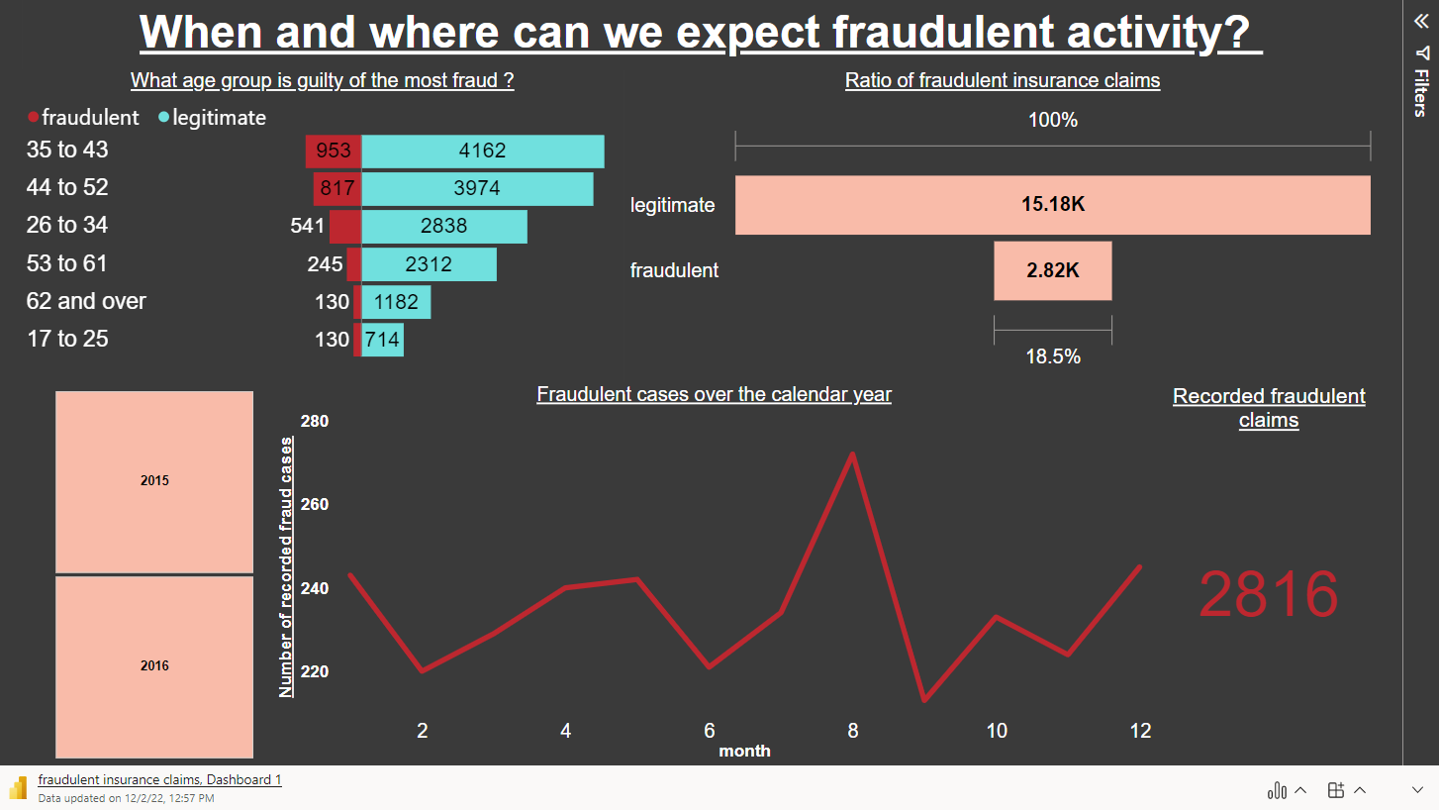

Slide 9
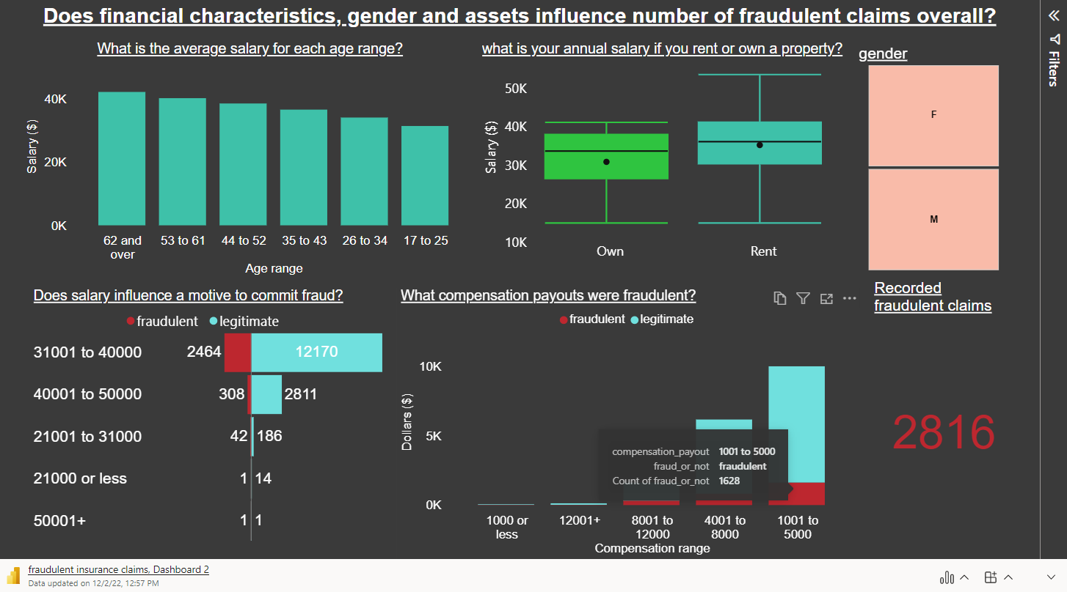

Slide 10
Machine Learning: classification
1.) Splitting data + standardisation
2.) Hyperperameter tuning + CV
3.) Over and/or under sampling
4.) Metrics

Slide 11
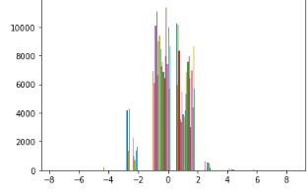
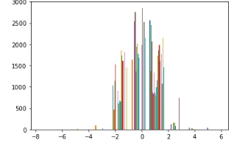
Splitting data + standardisation
Standardised training data
Standardised testing data
Reduce skewness and density of bounds
20% testing data
80% training data
Training data
Testing data

Slide 12
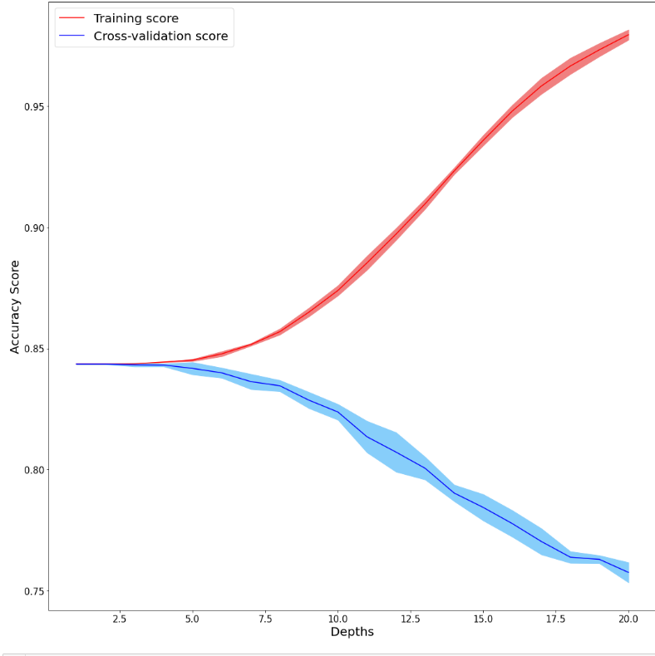
CV + hyperparameter tuning: Decision Tree Classifier
To avoid over and underfitting
Optimum depth: between 1 – 5
Based on split between training and testing and not train test split

Slide 13
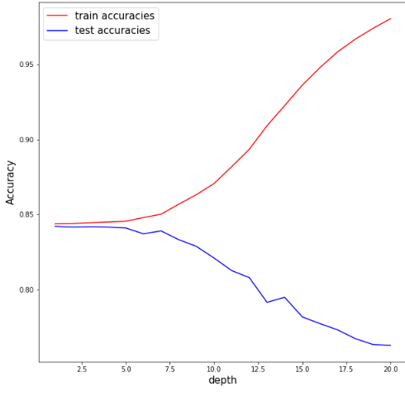
CV + hyperparameter tuning: Decision Tree Classifier
Further confirmed
Depth is still looking around 1 -5
From standardised data:
Hyperparameter scoring:
Criterion: Gini
Max depth: 4
Min sample leaf: 4
CV accuracy for test data :
~84%

Slide 14
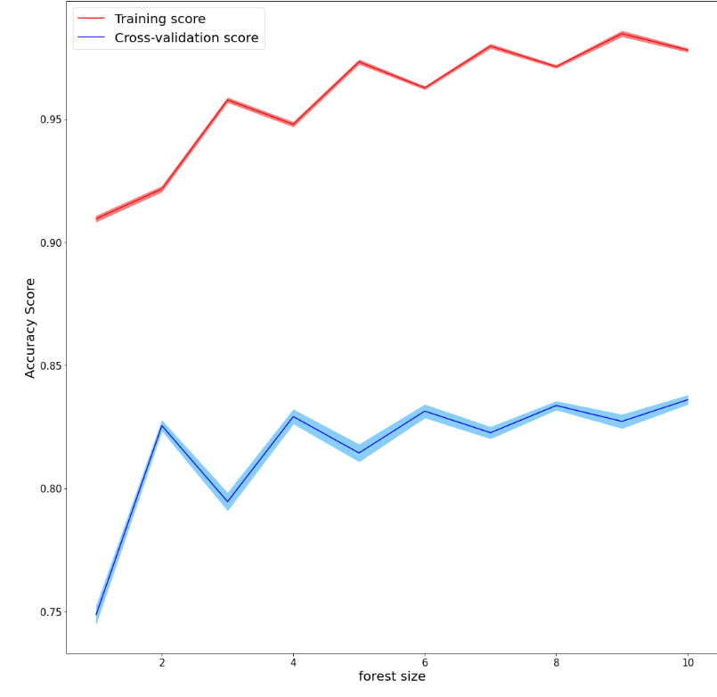
CV + hyperparameter tuning: Random Forest Classifier
Training score represents significant over fitting
CV has lower accuracy but confidence of no bias

Slide 15
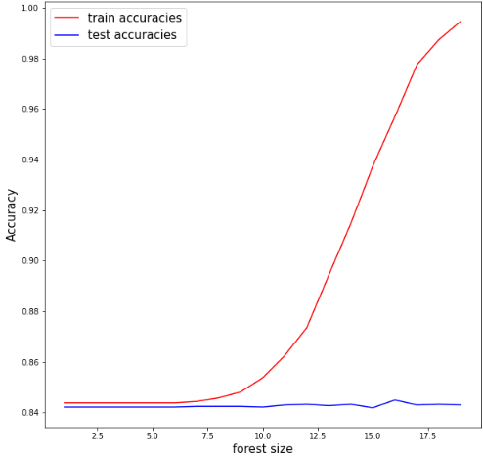
CV + hyperparameter tuning: Random Forest Classifier
After 7.5 forests: overfitting occurs
Testing accuracy didn’t change significantly.
Optimum Hyperparameters
Criterion: entropy
Max depth: 4
Min sample leaf: 4
Estimators = 30
CV accuracy for test data :
~84%

Slide 16
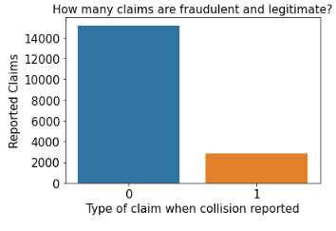
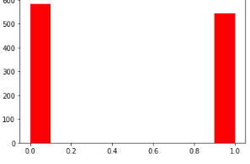
under-sampling
Original comparison:
Fraud = 1, legit = 0
Balanced dataset

Slide 17
Metrics: tuned parameters + metrics
Decision tree metrics
metrics | 0 (legitimate) | 1 (Fraudulent)
Recall | 57% | 66%
Precision | 64% | 59%
F1 | 61% | 62%
Accuracy: 61%
Random Forest metrics
metrics | 0 (legitimate) | 1 (Fraudulent)
Recall | 60% | 67%
Precision | 66% | 61%
F1 | 63% | 64%
Accuracy: 63%

Slide 18
conclusions
Conclusions
Fraud cases appear to increase every year
More sophistication
Middle aged clients report more claims but commit more fraudulent
While financial state is a factor, making more money and assets doesn’t seem to lead to greed
Decision tree model should be model of deployment for now

Slide 19
Recommendations
Random forest tends to be the more favoured classifier – more research needs to be done on validation procedures
Importance of features
Find data with more years
Up to date data

Slide 20
Recap
Motives and psychology behind fraud
Cleaning process and tools used
Analysis and visualisations
Machine learning testing

Slide 21
Thanks for listening! Questions?

